Slide 1

Organ Donation Application
BY- SAPNA PATEL, SWATI PANDEY AND NEEL SHAH

Slide 2
INTRODUCTION
It has been over 50 years since organ transplantation was discovered and many lives have been saved since
since 1988, more than 390,000 organs have been transplanted, with 80 percent of them coming from deceased donors.
The Organ donation application is a Java-Swing Application used to make organ donation and transplant easier and efficient.

Slide 3
APPLICATIONS
The Organ Donation Application is a bridge between Patients needing an organ transplant and Donors who have pledged their organs for transplant
It helps complete the whole procedure of an organ transplant from a donor to a patient including request, transport, legalization and the final transplant of an organ

Slide 4
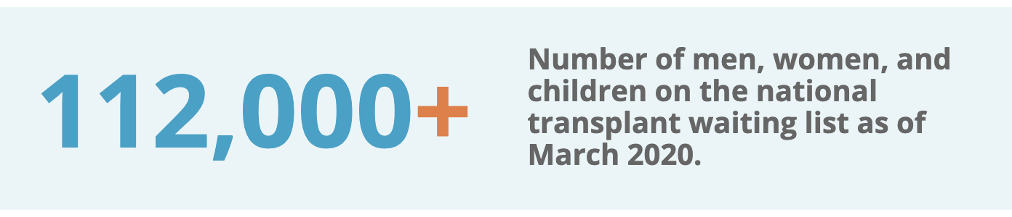
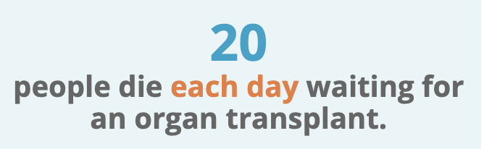
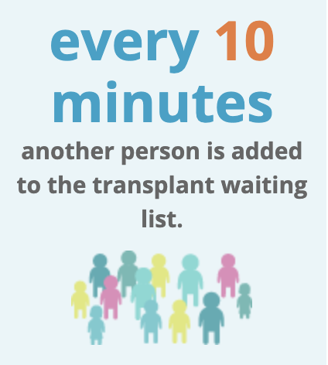
ISSUES FACED

Slide 5
ISSUES SOLVED
The long waitlist for a transplant is due to an ambiguous system being in place, the Organ Donation Application removes this ambiguity by organizing Donors and Patients .
Other problems being faced by patients are contacting different organizations for legalisation and transportation of the organ.
Our application provides all these services on one platform, hence decreasing the delay and hassle, which can be a make or break situation under such circumstances.

Slide 6
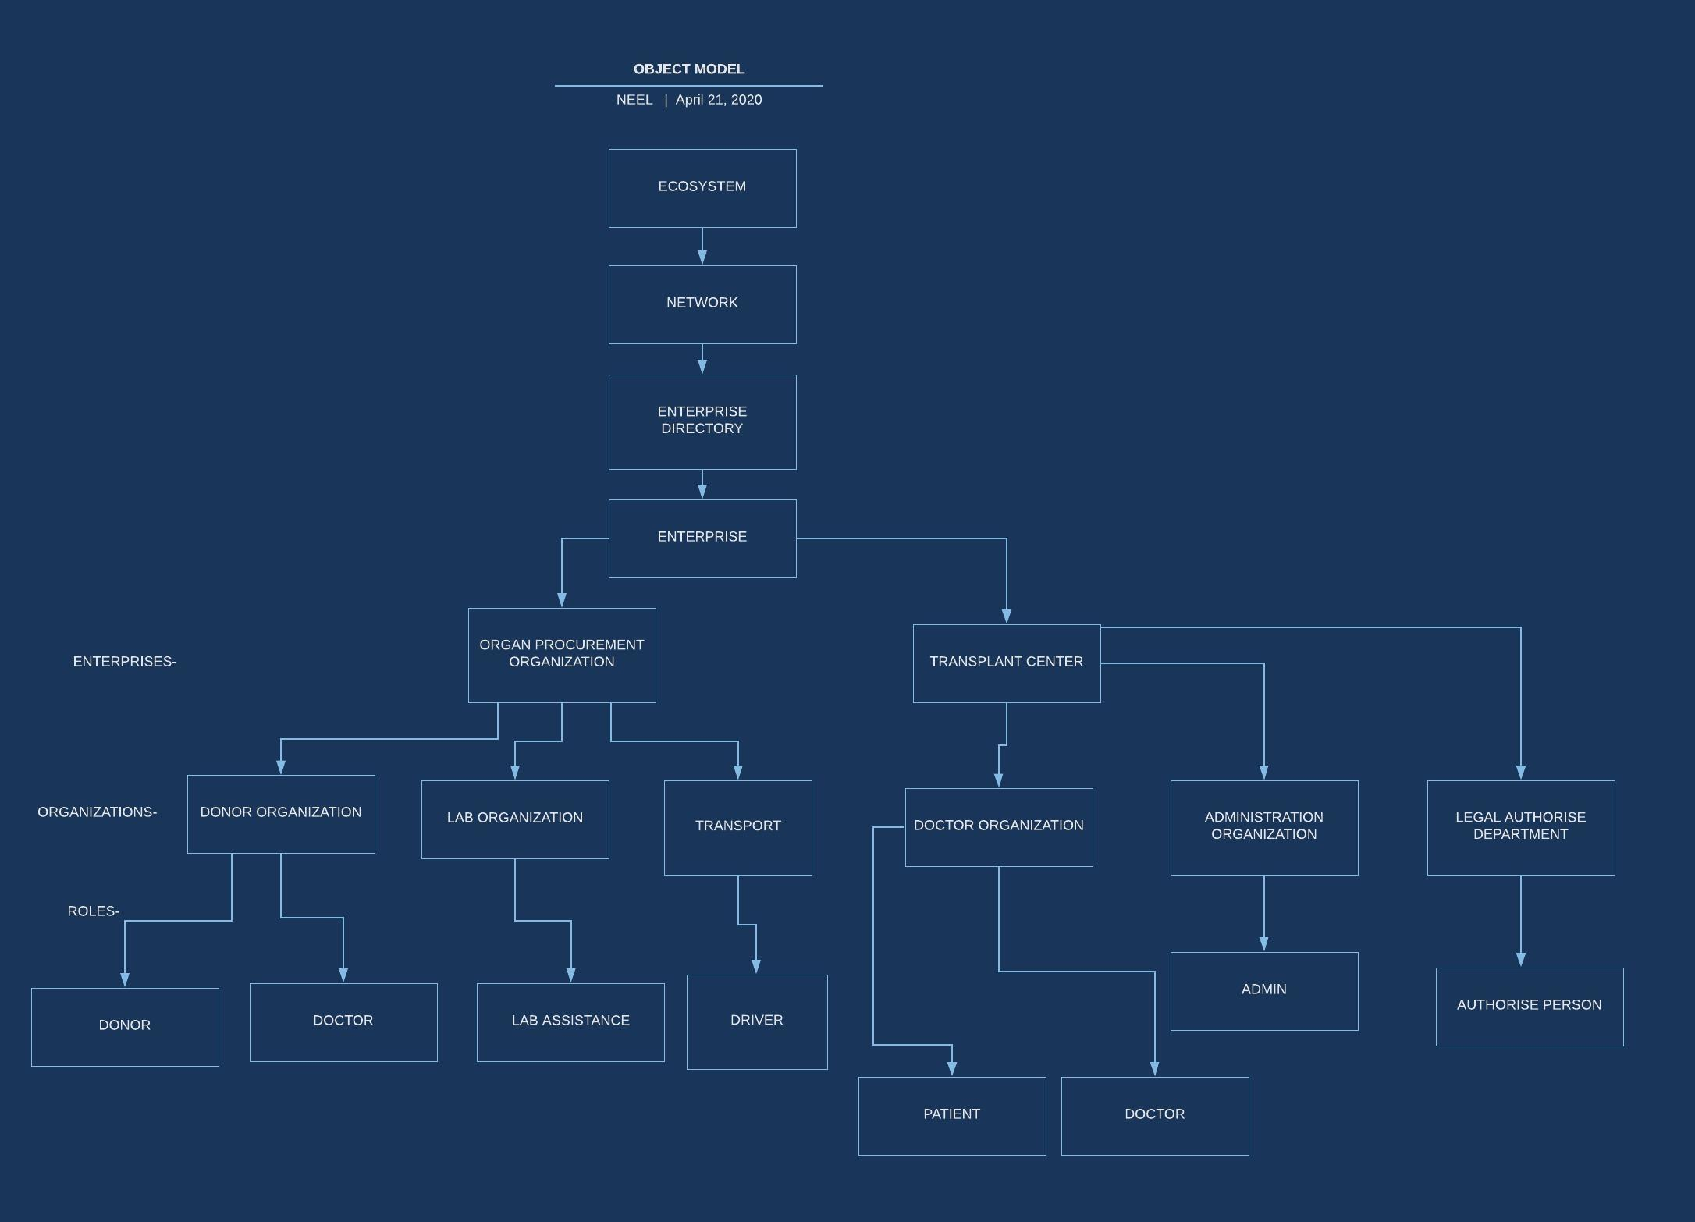
ECOSYSTEM ARCHITECTURE DIAGRAM

Slide 7
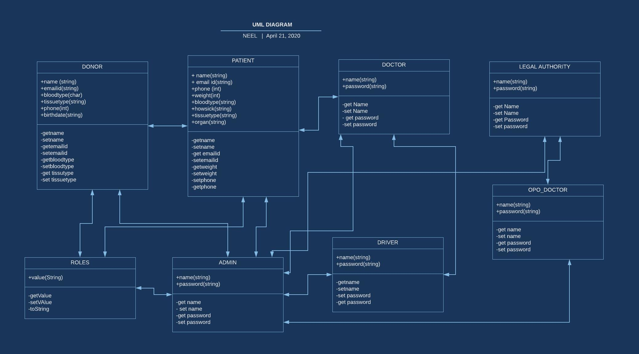
UML DIAGRAM

Slide 8
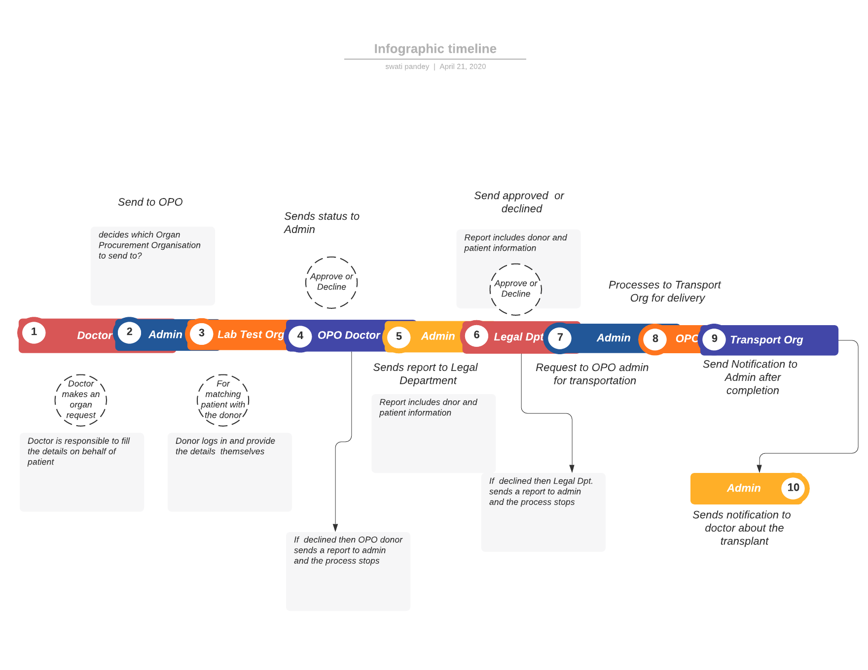
WORK FLOW

Slide 9
ROLES
DONOR: pledges and registers for organ donation
DOCTOR: Add details of patient who need organ and make request for organ
AUTHORISE PERSON : authorises the transplant, handles legality
ADMIN: responsible to handle all the process , who send request to organ procurement organization, handle transplant legality and delivery of organ
LAB ASSISTANCE: hs all donor vital signs and find perfect match for patient
DRIVER : will be responsible to deliver the organ

Slide 10
KEY FEATURES
Doctor can request for an organ when needed by a patient
Vital Signs can be matched before organ transplant
Appropriate emails can be sent whenever needed
Organ can be assigned to driver for transport from facility to hospital
The admin can accept or decline requests as needed

Slide 11
THE END

